Slide 1
Regular Expressions
Abylkassymova A.B.

Slide 2


What is it? Why do we need?
There are a lot of built-in methods for strings in python (replace - to replace all occurrences of one string with another; index – to ﬁnd the ﬁrst occurrence of a substring in a string;……….).
For example, you may need to ﬁnd all of the occurrences of a string instead of just the ﬁrst one.
Or maybe you want to ﬁnd all occurrences of two letters followed by a number.
Or perhaps you need to replace every 'qu' that is at the start of a word with 'Qu'.
This is what regular expressions are for.

Slide 3
Regular Expressions
In computing, a regular expression, also referred to as "regex" or "regexp", provides a concise and flexible means for matching strings of text, such as particular characters, words, or patterns of characters. A regular expression is written in a formal language that can be interpreted by a regular expression processor.

Slide 4
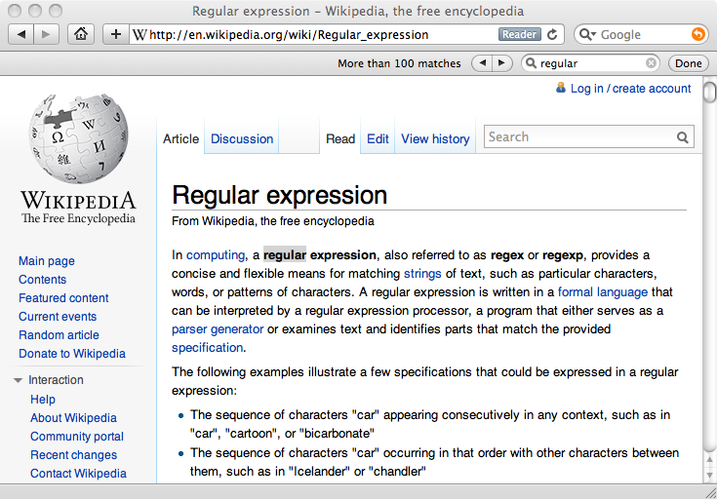
Really smart "Find" or "Search"

Slide 5
Understanding Regular Expressions
Very powerful and quite cryptic
Fun once you understand them
Regular expressions are a language unto themselves
A language of "marker characters" - programming with characters
It is kind of an "old school" language - compact

Slide 6
Simple example
REQUIRED module!
sub(pattern, replacement, string)!

Slide 7
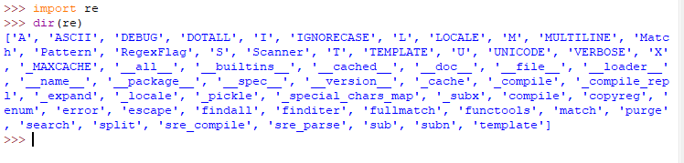
Available methods

Slide 8
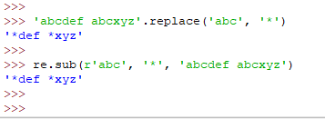
String method VS REGEX
Replace method is quite good now….. But what if we need to replace EVERY CERTAIN SYMBOL TO SMTH????

Slide 9


Another Patterns (Square brackets)
replaces every a and d with asterisk
An asterisk replaces all occurrences of an a, b, or c that is followed by 1, 2, or 3

Slide 10
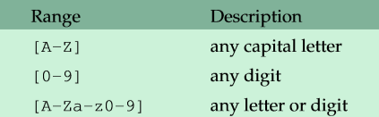
So….
We can give ranges of values—for example, [a-j] for the letters a through j. Here are some further examples of ranges:

Slide 11

Matching any character
Use a dot to match (almost) any character.
A followed by almost any single character followed by a B

Slide 12

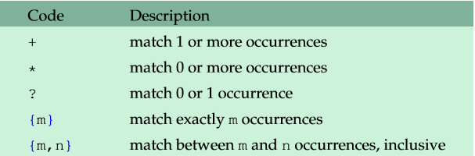
Matching multiple copies of smth
to match one or more B’s here
For instance, using * in place of + will match zero or moreB’s.

Slide 13
Greedy or not pattern?
Greedy – ate all 6 B’s
NOT Greedy – ate only 3 B’s

Slide 14

The | character
The | character acts as an “or.”

Slide 15


Matching only at the start or end
To match just the ﬁrst occurrence of something, start the pattern off with the ^ character.
To match just the last occurrence, end the pattern with the $ character.

Slide 16


Escaping special characters
We have seen that + and * have special meanings. What if we need to match a plus sign? To do so, use the backslash to escape it, like \+.

Slide 17
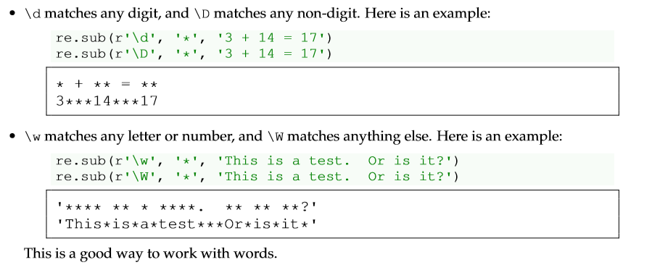
Backslash sequences

Slide 18
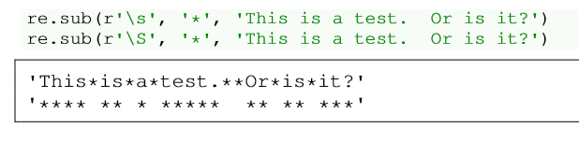
Backslash sequences (CONTINUE)
…………………….

Slide 19
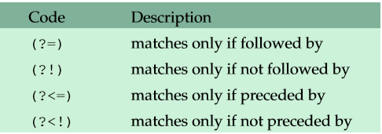
Preceding and following matches
Sometimes you want to match things if they are preceded or followed by something.
matched the word the only if it is followed by cat
the word the only if it is preceded by a space

Slide 20

Combined example
Neither preceded by and nor followed by letters

Slide 21
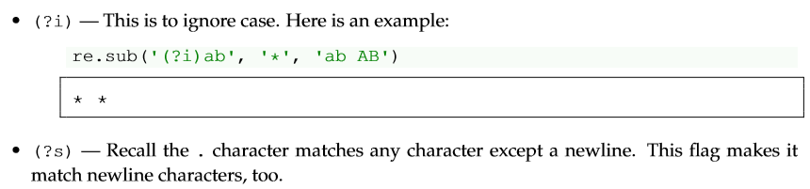
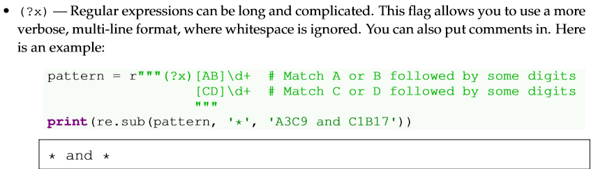
Flags
There are a few ﬂags that you can use to affect the behavior of a regular expression:

Slide 22
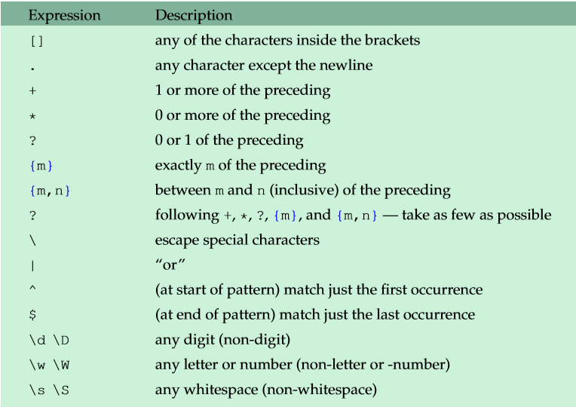
Summary (1)

Slide 23
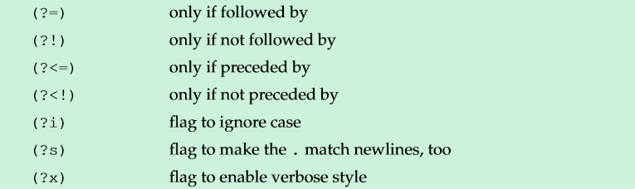
Summary (2)

Slide 24
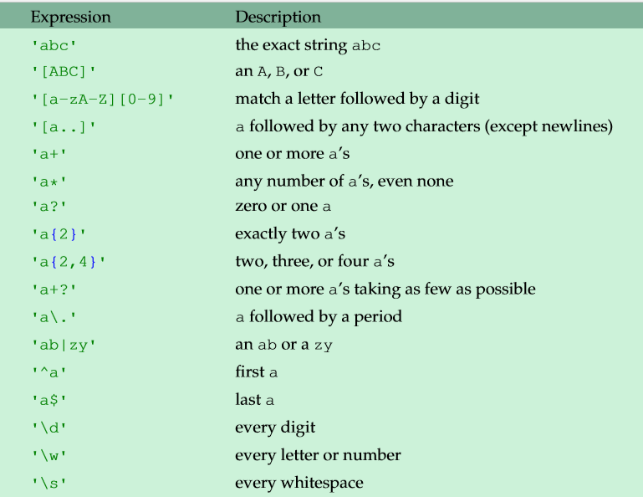
Some examples in a table view (1)

Slide 25
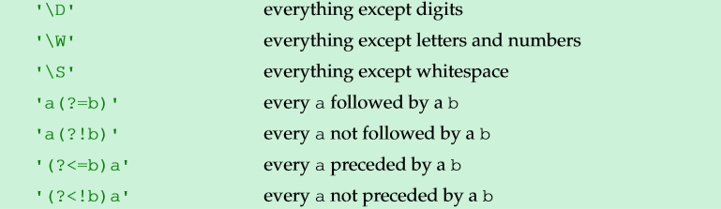
Some examples in a table view (2)

Slide 26
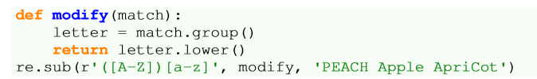

Groups
Using parentheses around part of an expression creates a group that contains the text that matches a pattern.
1 - The modify function ends up getting called three times, one for each time a match occurs.
2 - The re.sub function automatically sends to the modify function a Match object, which we name match.
3 - This object contains information about the matching text.
4 - The object’s group method returns the matching text itself.

Slide 27
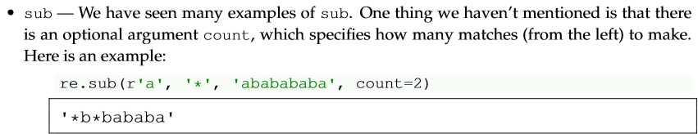
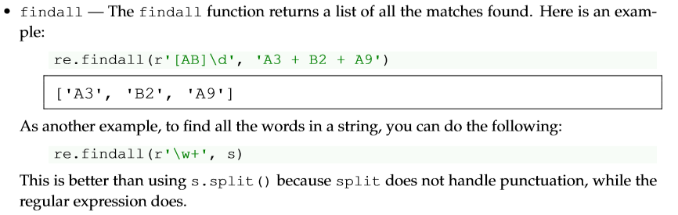
Other functions (1)

Slide 28
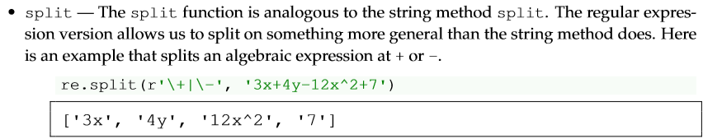
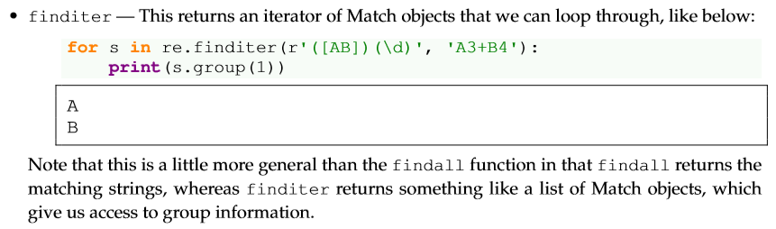
Other functions (2)

Slide 29
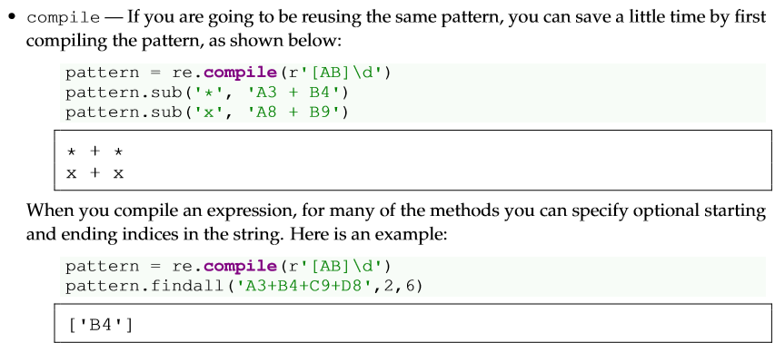
Other functions (3)

Slide 30
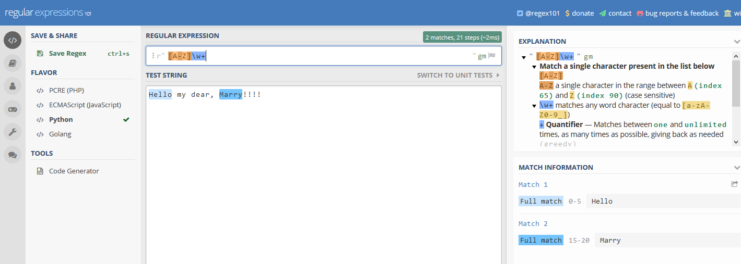
Regex101.com

Slide 31
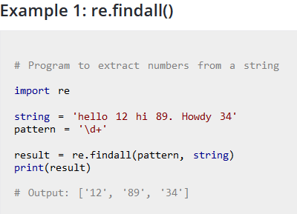

Slide 32
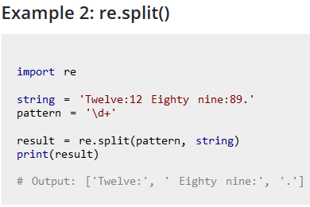
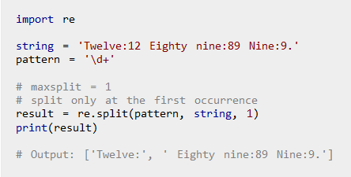
See the difference?

Slide 33
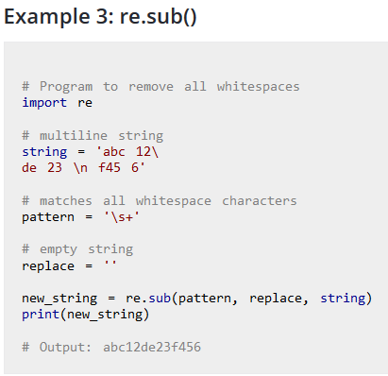

Slide 34
